Slide 1
CHAPTER 1
INTRODUCTION
“Principles of Soft Computing, 2nd Edition”
by S.N. Sivanandam & SN Deepa
Copyright © 2011 Wiley India Pvt. Ltd. All rights reserved.

Slide 2
SOFT COMPUTING (SC)
Soft Computing (SC): The symbiotic use of many emerging problem-solving disciplines.
According to Prof. Zadeh:
  "...in contrast to traditional hard computing, soft computing exploits the tolerance for imprecision, uncertainty, and partial truth to achieve tractability, robustness, low solution-cost, and better rapport with reality”
  Soft Computing Main Components:
  Approximate Reasoning
  Search & Optimization
    Neural Networks, Fuzzy Logic, Evolutionary Algorithms
“Principles of Soft Computing, 2nd Edition”
by S.N. Sivanandam & SN Deepa
Copyright © 2011 Wiley India Pvt. Ltd. All rights reserved.

Slide 3
PROBLEM SOLVING TECHNIQUES
HARD COMPUTING
SOFT COMPUTING
Precise Models
Approximate Models
Traditional Numerical
Modeling and Search
Functional
Approximation
and Randomized
Search
Symbolic
Logic
Reasoning
Approximate
Reasoning
“Principles of Soft Computing, 2nd Edition”
by S.N. Sivanandam & SN Deepa
Copyright © 2011 Wiley India Pvt. Ltd. All rights reserved.

Slide 4
OVERVIEW OF TECHNIQUES IN SOFT COMPUTING
  Neural Networks
  Fuzzy Logic
  Genetic Algorithm
  Hybrid Systems
“Principles of Soft Computing, 2nd Edition”
by S.N. Sivanandam & SN Deepa
Copyright © 2011 Wiley India Pvt. Ltd. All rights reserved.

Slide 5
NEURAL NETWORKS
DARPA Neural Network Study (1988, AFCEA International Press, p. 60):
... a neural network is a system composed of many simple processing elements operating in parallel whose function is determined by network structure, connection strengths, and the processing performed at computing elements or nodes.
“Principles of Soft Computing, 2nd Edition”
by S.N. Sivanandam & SN Deepa
Copyright © 2011 Wiley India Pvt. Ltd. All rights reserved.

Slide 6
DEFINITIONS OF NEURAL NETWORKS
According to Haykin (1994), p. 2:
A neural network is a massively parallel distributed processor that has a natural propensity for storing experiential knowledge and making it available for use. It resembles the brain in two respects:
Knowledge is acquired by the network through a learning process.
Interneuron connection strengths known as synaptic weights are used to store the knowledge
“Principles of Soft Computing, 2nd Edition”
by S.N. Sivanandam & SN Deepa
Copyright © 2011 Wiley India Pvt. Ltd. All rights reserved.

Slide 7
According to Nigrin (1993), p. 11:
A neural network is a circuit composed of a very large number of simple processing elements that are neurally based. Each element operates only on local information.
Furthermore each element operates asynchronously; thus there is no overall system clock.
According to Zurada (1992):
Artificial neural systems, or neural networks, are physical cellular systems which can acquire, store and utilize experiential knowledge.
“Principles of Soft Computing, 2nd Edition”
by S.N. Sivanandam & SN Deepa
Copyright © 2011 Wiley India Pvt. Ltd. All rights reserved.

Slide 8
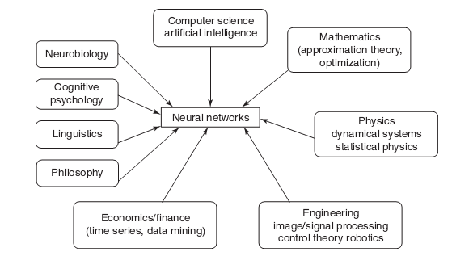
MULTIDISCIPLINARY VIEW OF NEURAL NETWORKS
“Principles of Soft Computing, 2nd Edition”
by S.N. Sivanandam & SN Deepa
Copyright © 2011 Wiley India Pvt. Ltd. All rights reserved.

Slide 9
FUZZY LOGIC
Origins: Multivalued Logic for treatment of imprecision and vagueness
  1930s: Post, Kleene, and Lukasiewicz attempted to represent undetermined, unknown, and other possible intermediate truth-values.
  1937: Max Black suggested the use of a consistency profile to represent vague (ambiguous) concepts.
  1965: Zadeh proposed a complete theory of fuzzy sets (and its isomorphic fuzzy logic), to represent and manipulate ill-defined concepts.
“Principles of Soft Computing, 2nd Edition”
by S.N. Sivanandam & SN Deepa
Copyright © 2011 Wiley India Pvt. Ltd. All rights reserved.

Slide 10
FUZZY LOGIC – LINGUISTIC VARIABLES
  Fuzzy logic gives us a language (with syntax and local semantics) in which we can translate our qualitative domain knowledge.
  Linguistic variables to model dynamic systems
  These variables take linguistic values that are characterized by:
  a label - a sentence generated from the syntax
  a meaning - a membership function determined by a local semantic procedure
“Principles of Soft Computing, 2nd Edition”
by S.N. Sivanandam & SN Deepa
Copyright © 2011 Wiley India Pvt. Ltd. All rights reserved.

Slide 11
FUZZY LOGIC – REASONING METHODS
  The meaning of a linguistic variable may be interpreted as an elastic constraint on its value.
  These constraints are propagated by fuzzy inference operations, based on the generalized modus-ponens.
  An FL Controller (FLC) applies this reasoning system to a Knowledge Base (KB) containing the problem domain heuristics.
  The inference is the result of interpolating among the outputs of all relevant rules.
  The outcome is a membership distribution on the output space, which is defuzzified to produce a crisp output.
“Principles of Soft Computing, 2nd Edition”
by S.N. Sivanandam & SN Deepa
Copyright © 2011 Wiley India Pvt. Ltd. All rights reserved.

Slide 12
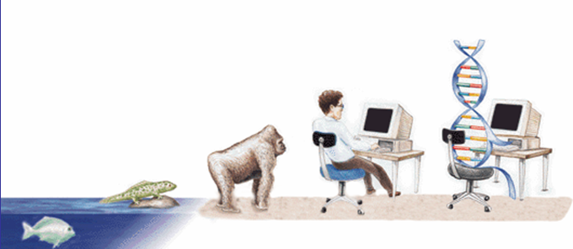
GENETIC ALGORITHM
EVOLUTIONARY PROCESS
“Principles of Soft Computing, 2nd Edition”
by S.N. Sivanandam & SN Deepa
Copyright © 2011 Wiley India Pvt. Ltd. All rights reserved.

Slide 13
DEFINITION OF GENETIC ALGORITHM
  The genetic algorithm is a probabalistic search algorithm that iteratively transforms a set (called a population) of mathematical objects (typically fixed-length binary character strings), each with an associated fitness value, into a new population of offspring objects using the Darwinian principle of natural selection and using operations that are patterned after naturally occurring genetic operations, such as crossover (sexual recombination) and mutation.
“Principles of Soft Computing, 2nd Edition”
by S.N. Sivanandam & SN Deepa
Copyright © 2011 Wiley India Pvt. Ltd. All rights reserved.

Slide 14
STEPS INVOLVED IN GENETIC ALGORITHM
The genetic algorithms follow the evolution process in the nature to find the better solutions of some complicated problems. Foundations of genetic algorithms are given in Holland (1975) and Goldberg (1989) books.
Genetic algorithms consist the following steps:
Initialization
Selection
Reproduction with crossover and mutation
Selection and reproduction are repeated for each generation until a solution is reached.
During this procedure a certain strings of symbols, known as chromosomes, evaluate toward better solution.
“Principles of Soft Computing, 2nd Edition”
by S.N. Sivanandam & SN Deepa
Copyright © 2011 Wiley India Pvt. Ltd. All rights reserved.

Slide 15
HYBRID SYSTEMS
Hybrid systems enables one to combine various soft computing paradigms and result in a best solution. The major three hybrid systems are as follows:
  Hybrid Fuzzy Logic (FL) Systems
  Hybrid Neural Network (NN) Systems
  Hybrid Evolutionary Algorithm (EA) Systems
“Principles of Soft Computing, 2nd Edition”
by S.N. Sivanandam & SN Deepa
Copyright © 2011 Wiley India Pvt. Ltd. All rights reserved.

Slide 16
SOFT COMPUTING: HYBRID FL SYSTEMS
Approximate Reasoning
Functional Approximation/ Randomized Search
Probabilistic
Models
Multivalued &
Fuzzy Logics
Neural
Networks
Evolutionary
Algorithms
Fuzzy
Systems
Multivalued
Algebras
Fuzzy Logic
Controllers
HYBRID FL SYSTEMS
NN modified by FS
(Fuzzy Neural
Systems)
FLC Tuned by NN
(Neural Fuzzy
Systems)
FLC Generated
and Tuned by EA
“Principles of Soft Computing, 2nd Edition”
by S.N. Sivanandam & SN Deepa
Copyright © 2011 Wiley India Pvt. Ltd. All rights reserved.

Slide 17
SOFT COMPUTING: HYBRID NN SYSTEMS
Approximate Reasoning
Functional Approximation/ Randomized Search
Probabilistic
Models
Multivalued &
Fuzzy Logics
Neural
Networks
Evolutionary
Algorithms
Feedforward
NN
Recurrent
NN
RBF
Single/Multiple
Layer Perceptron
Hopfield
SOM
ART
HYBRID NN SYSTEMS
NN parameters
(learning rate h
momentum a )
NN topology and/or
weights
controlled by FLC
generated by EAs
“Principles of Soft Computing, 2nd Edition”
by S.N. Sivanandam & SN Deepa
Copyright © 2011 Wiley India Pvt. Ltd. All rights reserved.

Slide 18
SOFT COMPUTING: HYBRID EA SYSTEMS
Approximate Reasoning
Functional Approximation/ Randomized Search
Probabilistic
Models
Multivalued &
Fuzzy Logics
Neural
Networks
Evolutionary
Algorithms
Evolution
Genetic
Strategies
Algorithms
Evolutionary
Genetic
Programs
Programs
HYBRID EA SYSTEMS
EA parameters
EA-based search
EA parameters
(N, P
, P
)
inter-twined with
(Pop size, selection)
cr
mu
controlled by FLC
hill-climbing
controlled by EA
“Principles of Soft Computing, 2nd Edition”
by S.N. Sivanandam & SN Deepa
Copyright © 2011 Wiley India Pvt. Ltd. All rights reserved.

Slide 19
APPLICATIONS OF SOFT COMPUTING
Handwriting Recognition
Image Processing and Data Compression
Automotive Systems and Manufacturing
Soft Computing to Architecture
Decision-support Systems
Soft Computing to Power Systems
Neuro Fuzzy systems
Fuzzy Logic Control
Machine Learning Applications
Speech and Vision Recognition Systems
Process Control and So on
“Principles of Soft Computing, 2nd Edition”
by S.N. Sivanandam & SN Deepa
Copyright © 2011 Wiley India Pvt. Ltd. All rights reserved.

